Slide 1
Multithreading in Java
Sonu Sharma
Associate Software Engineer – PSI HQ

Slide 2
Multithreading in Java?
Multithreading in Java is a process of executing multiple threads simultaneously.
A thread is a lightweight sub-process, the smallest unit of processing.
Multiprocessing and multithreading, both are used to achieve multitasking.
However, we use multithreading than multiprocessing because threads use a shared memory area. They don't allocate separate memory area so saves memory, and context-switching between the threads takes less time than process.
Java Multithreading is mostly used in games, animation, etc.

Slide 3
Advantages of Multithreading in Java?
It doesn't block the user because threads are independent and you can perform multiple operations at the same time.
You can perform many operations together, so it saves time.
Threads are independent, so it doesn't affect other threads if an exception occurs in a single thread.

Slide 4
Multitasking in Java
Multitasking is a process of executing multiple tasks simultaneously. We use multitasking to utilize the CPU. Multitasking can be achieved in two ways:
1. Process-based Multitasking (Multiprocessing)
2. Thread-based Multitasking (Multithreading)

Slide 5
Process Based Multitasking (Multiprocessing)
Each process has an address in memory. In other words, each process allocates a separate memory area.
A process is heavyweight.
Cost of communication between the process is high.
Switching from one process to another requires some time for saving and loading registers, memory maps, updating lists, etc.

Slide 6
Thread Based Multitasking (Multithreading)
Threads share the same address space.
A thread is lightweight.
Cost of communication between the thread is low.

Slide 7
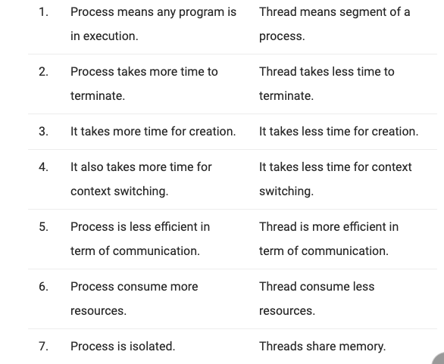
Process vs Thread

Slide 8
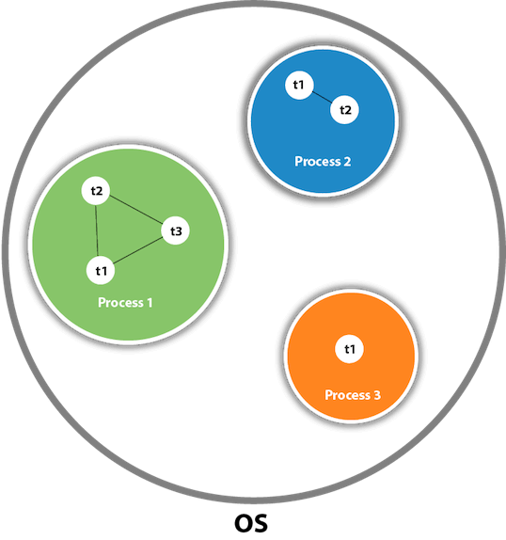
What is Thread in Java?
A thread is a lightweight sub process, the smallest unit of processing. It is a separate path of execution.
As shown in the above figure, a thread is executed inside the process. There is context-switching between the threads. There can be multiple processes inside the OS, and one process can have multiple threads.

Slide 9
Life cycle of a Thread (Thread Class)
1. New
2. Active
3. Blocked / Waiting
4. Timed Waiting
5. Terminated

Slide 10
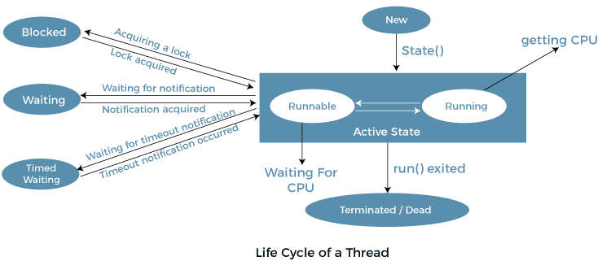
Life cycle of a Thread (Thread Class)

Slide 11
How to create thread in Java
There are two ways to create a thread:
1. By extending Thread class
2. By implementing Runnable interface.

Slide 12
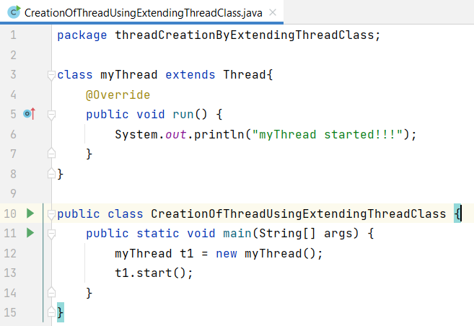
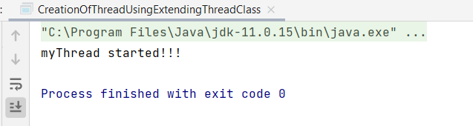
Thread creation using Thread Class

Slide 13
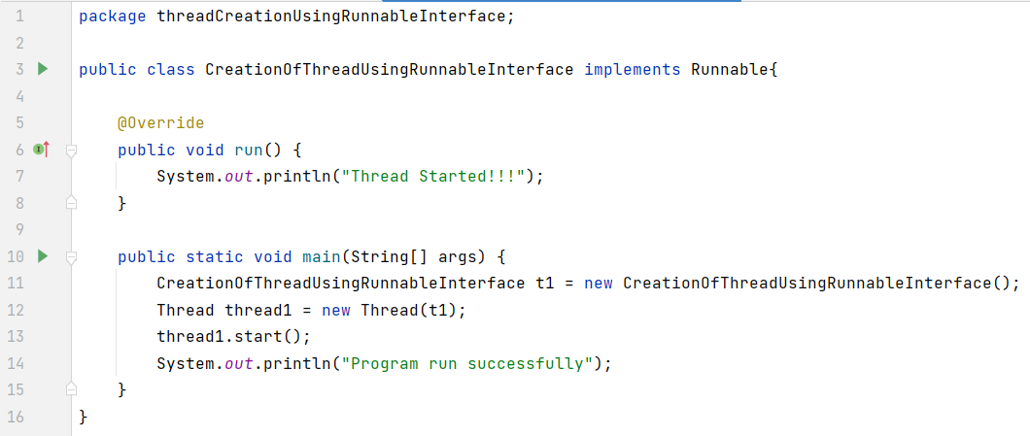
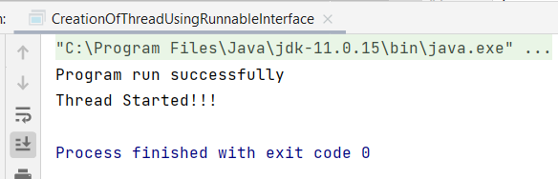
Thread creation using Runnable Interface

Slide 14
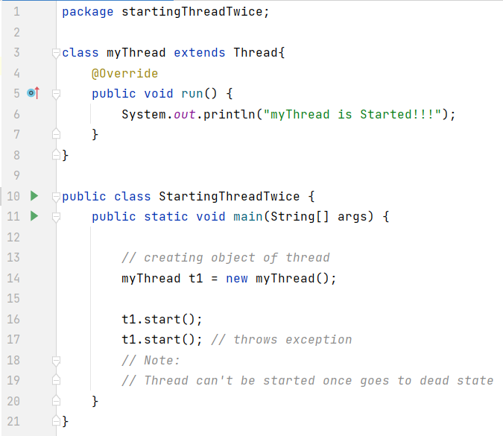
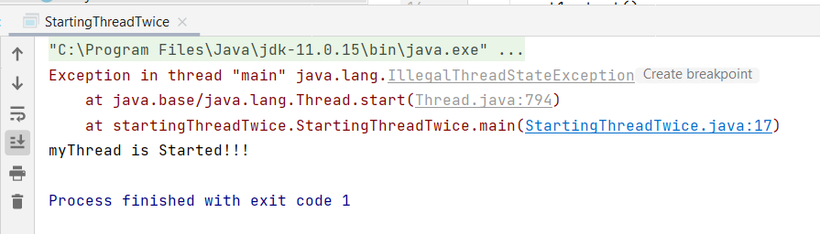
Can we start a thread twice
No. After starting a thread, it can never be started again. If you does so, an IllegalThreadStateException is thrown. In such case, thread will run once but for second time, it will throw exception.

Slide 15
Daemon Thread
Daemon thread in Java is a low-priority thread that runs in the background to perform tasks such as garbage collection.
Daemon thread in Java is also a service provider thread that provides services to the user thread.
Its life depends on the mercy of user threads i.e. when all the user threads die, JVM terminates this thread automatically.
In simple words, we can say that it provides services to user threads for background supporting tasks.
Example of Daemon Thread in Java:
Garbage collection in Java (gc),
finalizer, etc.

Slide 16
Properties of Java Daemon Thread
They can not prevent the JVM from exiting when all the user threads finish their execution.
JVM terminates itself when all user threads finish their execution.
If JVM finds a running daemon thread, it terminates the thread and, after that, shutdown it. JVM does not care whether the Daemon thread is running or not.
It is an utmost low priority thread.

Slide 17
Methods of Daemon Thread:
1. void setDaemon(boolean status):
2. boolean isDaemon():

Slide 18
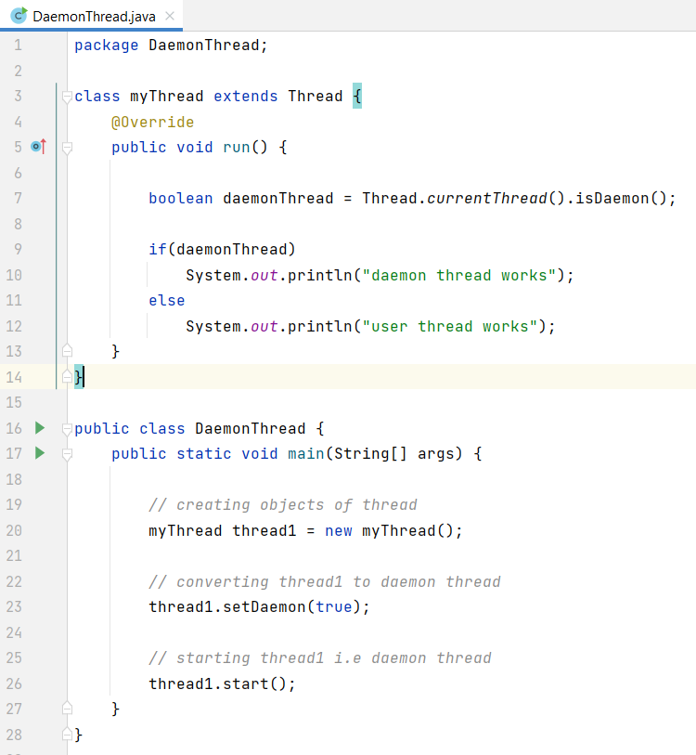
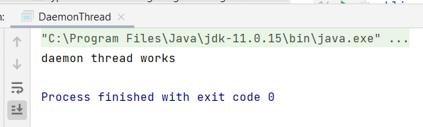
Methods of Daemon Thread:

Slide 19
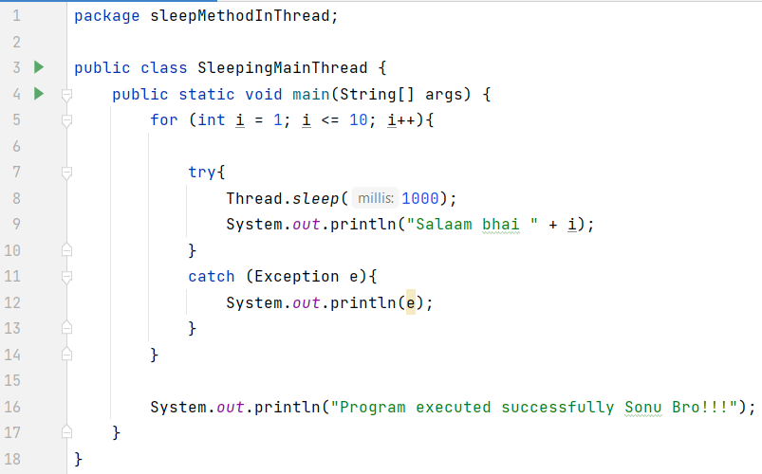
Sleep Method in Multithreading:

Slide 20
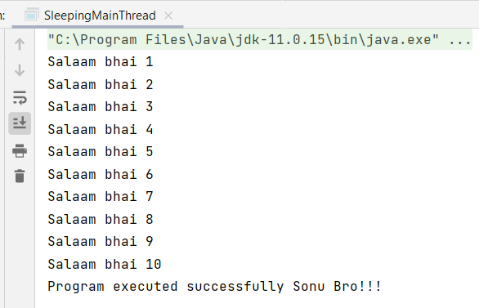
OUTPUT:-

Slide 21
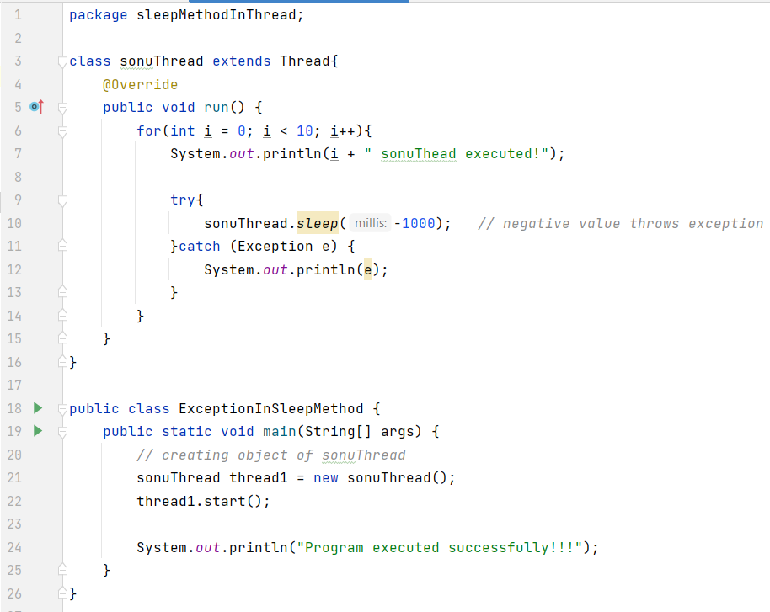
Exception in Sleep Method:-

Slide 22
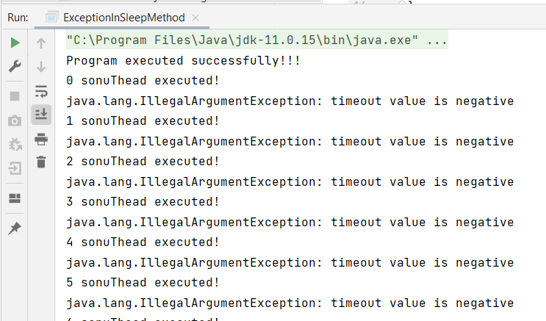
Exception in Sleep Method:-

Slide 23
Types of Multithreading
1. Single task from Single thread
2. Single task from Multiple thread
2. Multiple task from single thread
3. Multiple task from multiple thread

Slide 24
Types of Multithreading
1. Single task from Single thread
2. Single task from Multiple thread
2. Multiple task from single thread
3. Multiple task from multiple thread

Slide 25
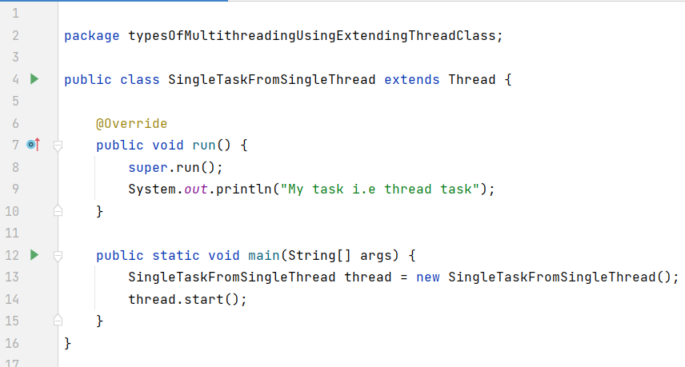
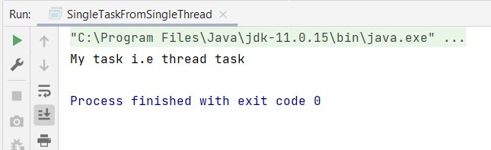
Single task from single thread

Slide 26
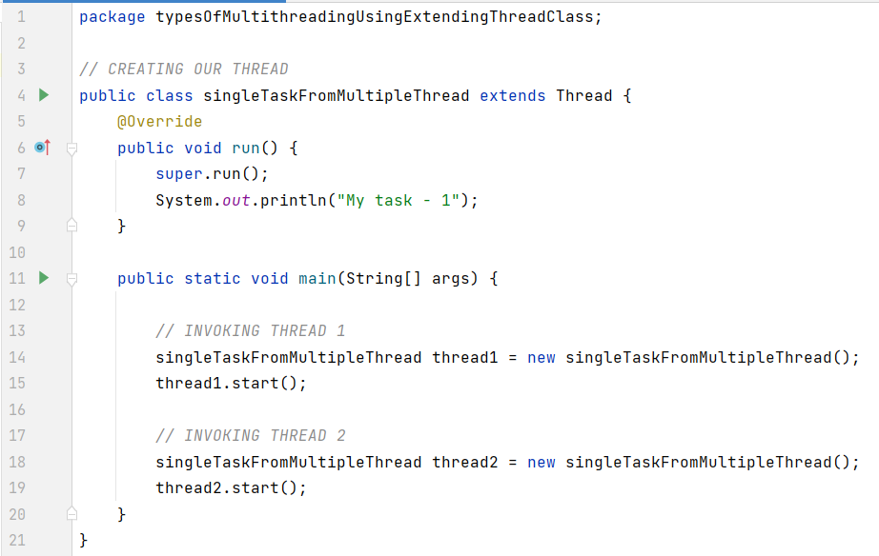
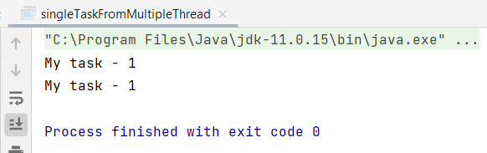
Single task from multiple thread:

Slide 27
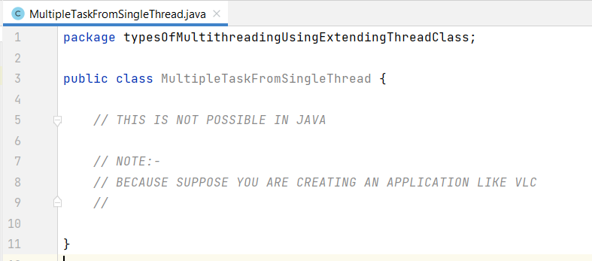
Multiple task from Single Thread:

Slide 28
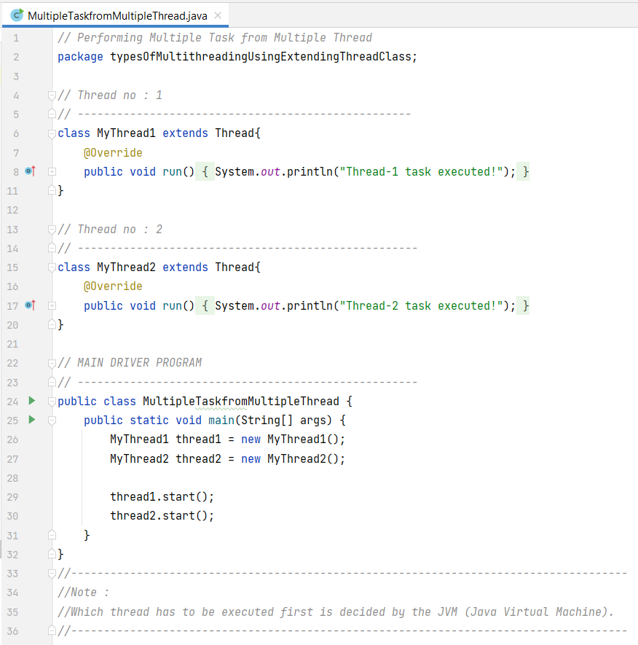
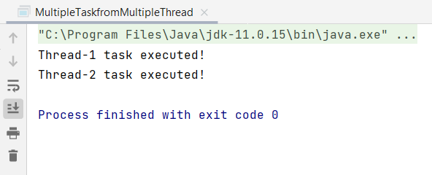
Multiple task from multiple thread:

Slide 29
Thank you :)
Sonu Sharma
Associate Software Engineer – PSI HQ

